Slide 1
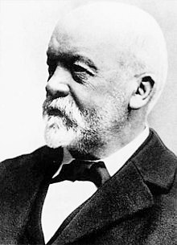
Gottlieb Daimler
By: Tanner Gibson

Slide 2
Who is Gottlieb Daimler?
First, he was born on 17 March 1834 in Schorndorf, Germany
Daimler was a mechanical engineer and industrial designer
He was a pioneer of internal-combustion engines and automobile development

Slide 3
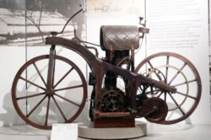
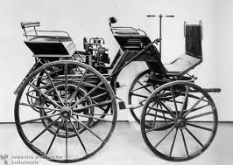
What did Daimler invent?
To make simple, Gottlieb Daimler made the World’s first motorcycle, automobile, and boat.
The “Reitwagon” (riding car) the World’s first motorcycle
“The Grandfather Clock”
The World’s first automobile

Slide 4
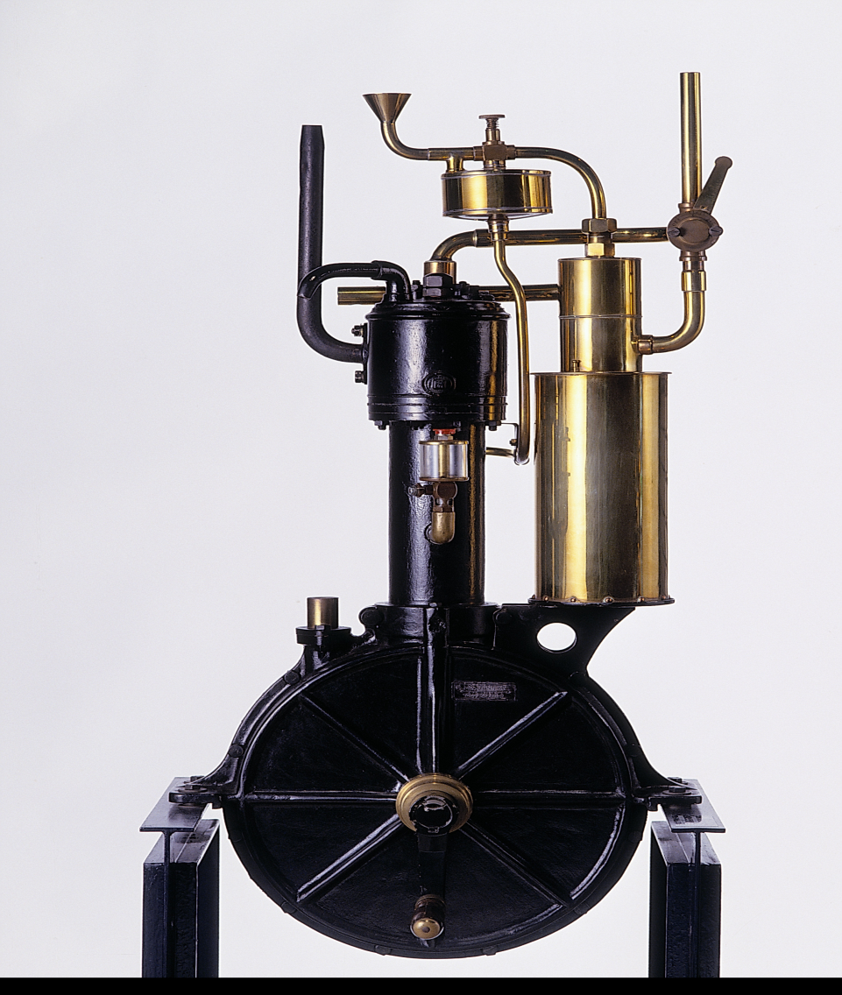
The Grandfather Clock Engine
This engine had an enclosed crankcase
On top on the crankcase was the air-cooled cylinder
It was called this because of the look the engine portrayed an old pendulum clock

Slide 5
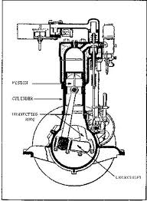
Some specs on the motor
This motor featured many things that are essential to today’s engines
Piston
Cylinder
Connecting Rods
Crankshaft

Slide 6
Daimler’s inventions
Unregulated hot-tube ignition, which is the device used to ignite the compressed fuel by using a flame to heat part of the tube red-hot, first spark plug
The “floating” carburetor, today known as the surface carburetor, made for problem-free combustion of fuel

Slide 7
Inventions continued
Daimler also invented the first four – speed transmission
This made it possible for you to have more speeds to choose from than just having two to choose from

Slide 8
The World’s first motorcycle
The first motorcycle was as simple as you could get
It had a wooden bicycle frame with solid rubber tires and Daimler just attached an engine to the frame
The motorcycle used the grandfather clock engine Daimler invented
Daimler would ride this bike
around his home in Cannstatt

Slide 9

The World’s first automobile
To accomplish this feat Daimler and Wilhelm Maybach had to tell the neighbors that they had secretly bought a stagecoach for Mrs. Daimler
But their true intentions were to install their upgraded grandfather clock to the chassis
The engine was a 1.1 hp, 462cc and reached speeds of 10 mph!!

Slide 10
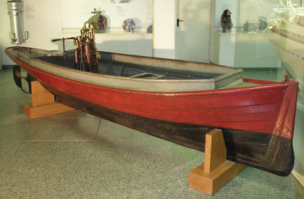
The World’s first motorized boat
This invention of adding the grandfather clock engine and a propeller to the back of a 15 foot long boat and achieved speeds of 6 mph
It was named “Neckar” after the river it was first tested in

Slide 11
Daimler-Motoren-Gesellschaft
Or DMG, was Daimler and Maybach’s company that they formed in 1887
They carefully hired 23 workers who had the passion and drive to make the best and most efficient engines
They had way too many employees for just testing the operation of the engines and ran into financial issues
This made them have to go to some people for financial aid and with the money made DMG a public company

Slide 12
Daimler’s death
He died on 6 March 1900 of heart compliant
His untimely death was just before everything he worked his life for took off
His works paved the way for the future of automobiles

Slide 13
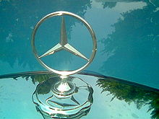
Daimler - Benz
There was competition among companies even from the very creation of the engine
The DMG and Karl Benz’s Benz and Cie signed an Agreement of Mutual Interest on 1 May 1924
With this agreement being signed they would use the name “Mercedes Benz”

Slide 14
Specs of engines Daimler made
The Grandfather Clock Engine (1885)
The Steel Wheel Automobile (1889)
a single horizontal cylinder of 264 cc (16 cu in) (58×100 mm, 2.28×3.94 in)
air cooling
large cast iron flywheel
hot tube ignition system (patent 28022)
cam operated exhaust valves, allowing high speed operation
0.5 hp (370 W)
600 rpm running speed, beating previous engines weight of around 50 kg (110 lb)
height of 76 cm (30 in)
high speed four-stroke petrol engine
fuel vaporization
2 cylinders V-configured
mushroom shaped valves
water-cooled
4 speed toothed gearbox
pioneer axle-pivot steering system

Slide 15
References
Bellis, Mary. "Gottlieb Daimler." About.com. The New York Times Company, January 2012. Web. 19 March 2012.
Georgano, G. N. A World of Wheels. Mason Crest Publishing, October 2002. .PDF file.
"Gottlieb Daimler." Encyclopedia of World Biography. Encyclopedia.com. January 2004. Web. 19 March 2012.
Stuttgart. "Gottlieb Daimler." Daimler.com. Daimler Motor Company, 3 March 2010.Web. 19 March 2012.
Wernle, Bradford. The Workaholic That Made the Automotive Revolution Possible. Automotive News Europe, August 2010. Web. 19 March 2012.
Zeleznik, F. J.; Mcbride, B. J.. "Modeling the Internal Combustion Engine". NASA Reference Publication. NASA Technical Reports Serve. 18 October 2011.Web. 29 March 2012.

